Slide 1
Computer Networks and Network Security
Qiao Xiang
https://qiaoxiang.me/courses/cnns-xmuf22/index.shtml
9/13/2022
This deck of slides are heavily based on CPSC 433/533 at Yale University, by courtesy of Dr. Y. Richard Yang.

Slide 2
Outline
Administrative trivia’s
What is a network protocol?
A brief introduction to the Internet: past and present
Summary

Slide 3


Personnel
Instructor
Qiao Xiang, qiaoxiang@xmu.edu.cn
office hours： by appointment
Teaching assistants
Xing Fang, fangxing@stu.xmu.edu.cn
Pengbo Yan, yanpengbo@stu.xmu.edu.cn

Slide 4

Self-Introduction
Joined XMU as a professor last January
Research: Computer Networks, Computer Systems
Previously,
Research assistant professor, Yale University, US., 2019-2020
Postdoctoral fellow, Yale University, US. 2016-2018
Postdoctoral fellow, McGill University, Canada, 2014-2015
Ph.D. in Computer Science, Wayne State University, US, 2014
B.E. in Information Security and B.Econ., NKU, 2007

Slide 5

Textbook
Textbook
Computer Networking: A Top-Down Approach, 7/e by Jim Kurose and Keith Ross
Reference books
Computer Networks by Tanenbaum and Wetherall
Computer Networks, A Systems Approach by Larry Peterson and Bruce Davie
TCP/IP Illustrated, Volume 1: The Protocols by W. Richard Stevens
Java Network Programming, by Elliotte Harold
Resources
https://qiaoxiang.me/courses/cnns-xmuf22/index.shtml
on

Slide 6
What are the Goals of this Course?
Learn design principles and techniques of:
the Internet infrastructure (Internet service provider, data center, cloud)
large-scale Internet applications
Focus on how the principles and techniques apply and adapt in real world:
real examples from the Internet

Slide 7
Computer Networks and Network Security vs. Computer Networks and Communication
CNNS:
Bilingual:
English in slides / homework / exams
Chinese in lecture / lab classes / discussions
More emphasis on design principles, theories and programming
More emphasis on security issues
Less emphasis on communication (e.g., physical layer and wireless networks)
A top-down roadmap

Slide 8
Why Study Computer Networks?
Looking for a job
Domestic | International
Huawei | Amazon
Alibaba | Google
Tencent | Microsoft
Xiaomi | Facebook
JD | Uber
… | …

Slide 9


Why Study Computer Networks?
Be an entrepreneur

Slide 10




Why Study Computer Networks?
Pursue graduate degrees overseas

Slide 11





Why Study Computer Networks?
Pursue graduate degrees domestically
Xin Jin
PKU
Tong Yang
PKU
Chenren Xu
PKU
Linghe Kong
SJTU
If you are interested in working with me on research projects, please send me an email at qiaoxiang@xmu.edu.cn
Chen Tian
NJU
Peng Zhang
XJTU
Qiao Xiang
XMU
Lu Tang
XMU

Slide 12

What Do You Need To Do?
Please go to the class website to fill out the class background survey
help us determine your background
help us determine the depth, topics, and the details of assignments
suggest topics that you want to be covered (if you think of a topic later, please send me email)

Slide 13
What Do You Need To Do?
Your workload
6-7 lab assignments
3-4 written assignments
3-4 programming assignments
one HTTP 1.0 server, one TCP, one routing protocol
1 class project （2-4 persons a team)
2 exams

Slide 14
How to Succeed in this Class?
Engage in lectures
Questions are highly encouraged
Read textbooks / references / online materials
Apply the principles / techniques you learned in lectures to assignments and the project
Do not procrastinate assignments and the project
For programming assignments and projects, follow the timeline of checkpoints to avoid the deadline panic

Slide 15
Class Project
Research or engineering project related to computer networks and network security
Grading criteria:
Innovation 25%, Practicality 25%, Completeness 25%, Presentation 25%
Suggestions
Identify teams and talk to the instructor to decide on the topic as early as possible
Read latest papers/technical documents to get inspiration
If possible, target research papers / patents
Suggested Topics: to be posted soon

Slide 16
Grading
Class Participation | 10%
Lab Assignments | 40%
Class Project | 15%
Exams | 15%+20%
Grades are important, but you do not need worry too much about them
More important is what you realize/learn than the grades !!

Slide 17
Questions?

Slide 18
Outline
Administrative trivia’s
What is a network protocol?

Slide 19
What is a Network Protocol?
A network protocol defines the format and the order of messages exchanged between two or more communicating entities, as well as the actions taken on the transmission and/or receipt of a message or other events.

Slide 20
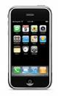
Example Protocol: Simple Mail Transfer Protocol (SMTP)
Messages from a client to a mail server
HELO
MAIL FROM: <address>
RCPT TO: <address>
DATA <This is the text end with a line with a single .>
QUIT
Messages from a mail server to a client
status code
The first digit of the response broadly indicates the success, failure, or progress of the previous command.
1xx - Informative message
2xx - Command ok
3xx - Command ok so far, send the rest of it.
4xx - Command was correct, but couldn't be performed for some reason.
5xx - Command unimplemented, or incorrect, or a serious program error occurred.
content
outgoing
message queue
user mailbox
user
agent
mail
server
user
agent
SMTP
mail
server
user
agent
SMTP
SMTP
mail
server
user
agent
POP3,
IMAP SMTP
user
agent
user
agent
Command: %telnet smtp.xmu.edu.cn 25
Notes:
RCPT TO: <> notify=success,failure

Slide 21
Example Protocol: TCP Connection Close Protocol
Why connection close?
so that each side can release resource and remove state about the communication
client
server
init. close
release
resource?
I am done. Are you done too?
close
I am done too. Goodbye!
release
resource?
close
release
resource?

Slide 22
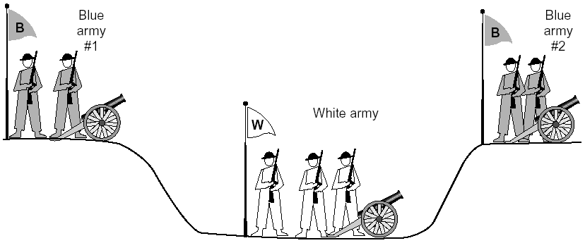
General Case: The Two-Army Problem
The gray (blue) armies need to agree on whether or not they will attack the white army. They achieve agreement by sending messengers to the other side. If they both agree, attack; otherwise, no. Note that a messenger can be captured!

Slide 23
Example: TCP Protocol Handshakes
Host A
SYN(seq=x)
Host B
ACK(seq=x), SYN(seq=y)
ACK(seq=y)
DATA(seq=x+1)
ACK
FIN
ACK
FIN
ACK

Slide 24
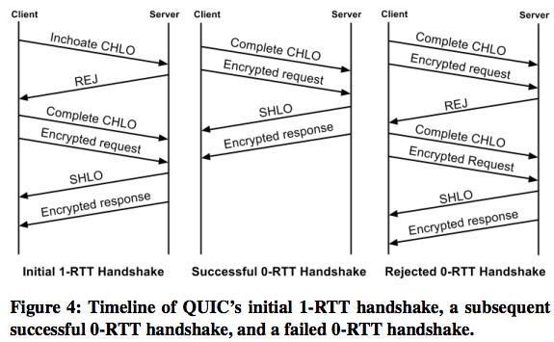
Example: Google’ new QUIC
http://conferences.sigcomm.org/sigcomm/2017/files/program/ts-5-1-QUIC.pdf

Slide 25
Protocol Standardization
Most widely used protocols are defined in standards
Why standard?

Slide 26
Internet Standardization Process
All standards of the Internet are published as RFC (Request for Comments)
e.g., the SMTP protocol is specified in RFC821
but not all RFCs are Internet Standards: http://qiaoxiang.me/courses/cnns-xmuf22/readings/interestingrfcs.html

Slide 27
Internet Standardization Process
All standards of the Internet are published as RFC (Request for Comments)
e.g., the SMTP protocol is specified in RFC821
but not all RFCs are Internet Standards: http://qiaoxiang.me/courses/cnns-xmuf21/readings/interestingrfcs.html
A typical (but not the only) way of standardization:
Internet draft
RFC
proposed standard
draft standard (requires 2 working implementations)
Internet standard (declared by Internet Architecture Board)
David Clark, 1992:
We reject: kings, presidents, and voting. We believe in: rough consensus and running code.

Slide 28

Outline
Administrative trivia’s
What is a network protocol?
A brief introduction to the Internet
past (a brief history)
present

Slide 29
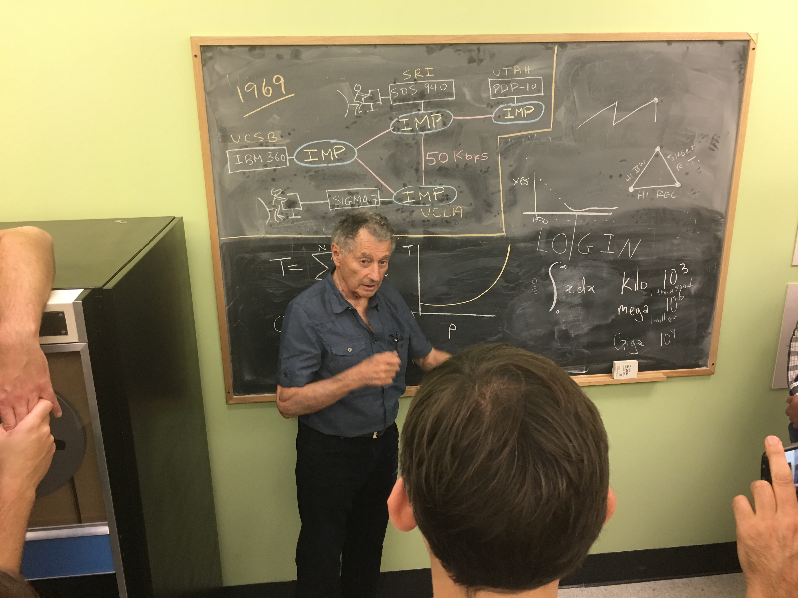
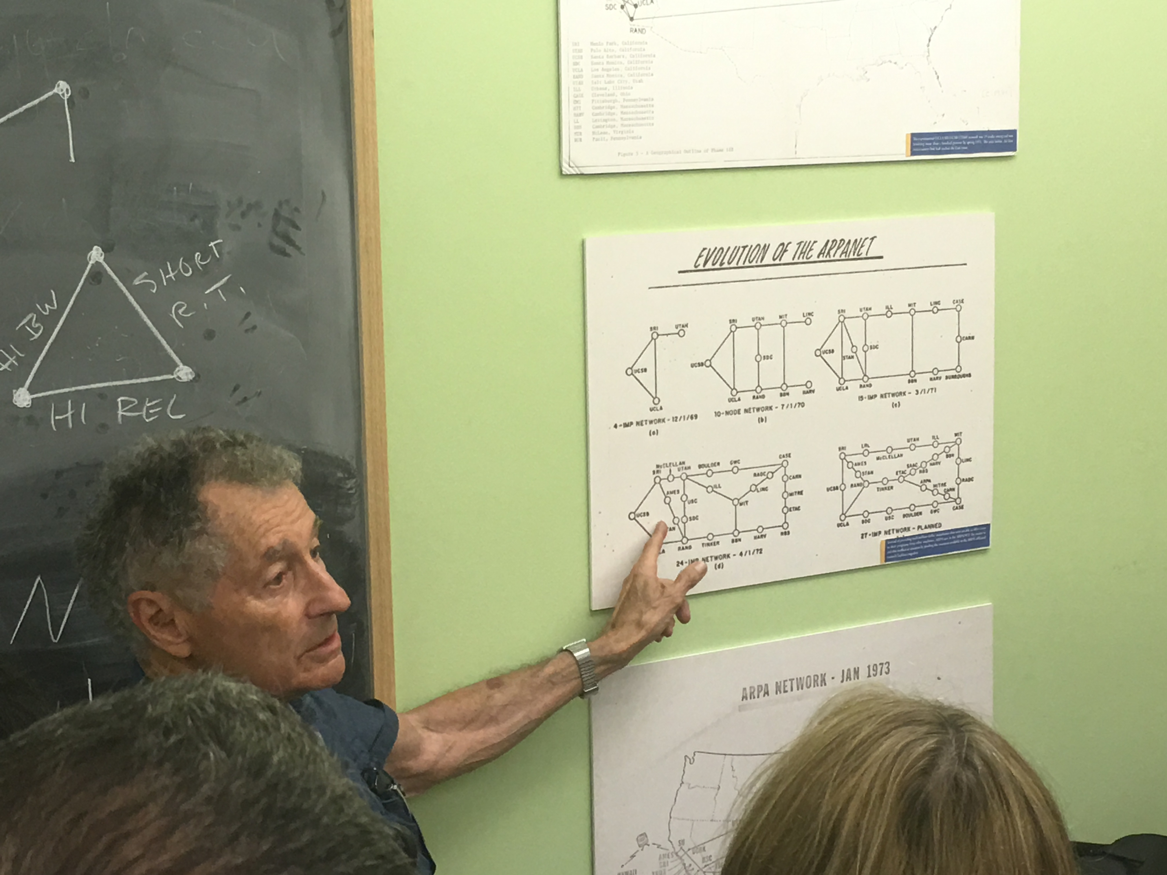
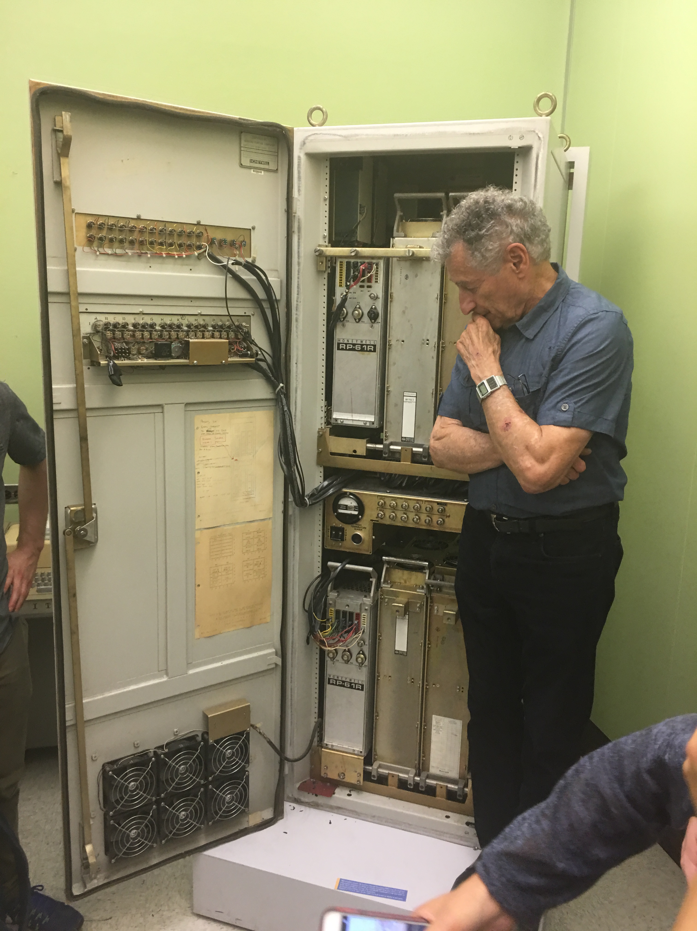
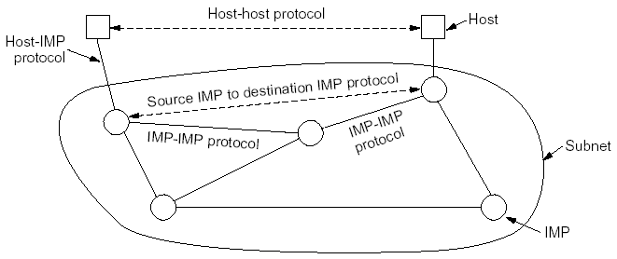
Prelude: Packet Switching and ARPANET
1957
USSR launched Sputnik; US DoD formed Advanced Research Projects Agency (ARPA)
1961
First paper by Len Kleinrock on packet switching theory
1964
Paul Baran from RAND on design of packet switching networks
1965-1968
ARPANET plan
Bolt Beranek and Newman, Inc. (BBN), a small company, was awarded Packet Switch contract to build Interface Message Processors (IMPs)

Slide 30
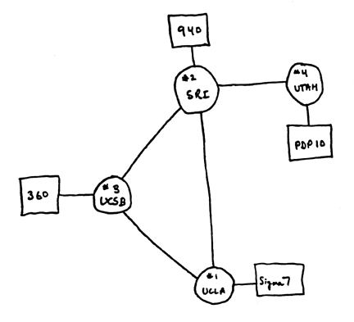
Internet 1.0: Initial ARPANET
1969
ARPANET commissioned: 4 nodes, 50kbps

Slide 31
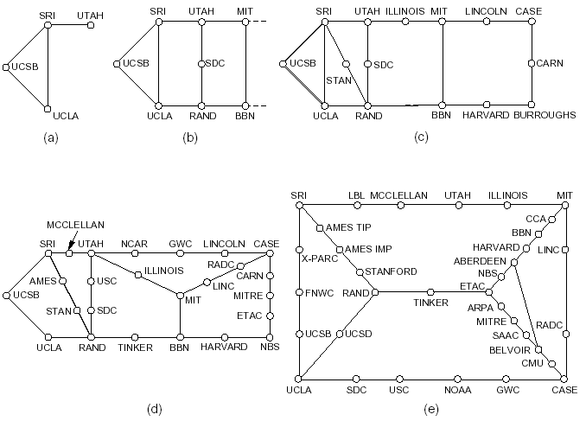
Initial Expansion of the ARPANET
Dec. 1969
July 1970
Mar. 1971
Apr. 1972
Sept. 1972
RFC 527: ARPAWOCKY; RFC 602: The Stockings Were Hung by the Chimney with Care

Slide 32
The Internet Becomes a Network of Networks
1970: ALOHAnet, the first packet radio network, developed by Norman Abramson, Univ of Hawaii, becomed operational
1973: Bob Kahn posed the Internet problem---how to connect ARPANET, packet radio network, and satellite network
1974: Vint Cerf, Bob Kahn published initial design of TCP (NCP) to connect multiple networks
- 1978: TCP (NCP) split to TCP/IP
- 1983: TCP (NCP) converted to TCP/IP (Jan. 1)

Slide 33
Growth of the Internet
1981: BITNET (Because It’s Time NETwork) between CUNY and Yale
1986: NSF builds NSFNET as backbone, links 6 supercomputer centers, 56 kbps; this allows an explosion of connections, especially from universities
1987: 10,000 hosts
1987： China's first email "Across the Great Wall we can reach every corner in the world" sent to Germany
1988: Internet congestion collapse; TCP congestion control
1989: 100,000 hosts RFC 1121: Act One – The Poem WELCOME by Leonard Kleinrock We've gathered here for two days to examine and debate And reflect on data networks and as well to celebrate. To recognize the leaders and recount the path we took. We'll begin with how it happened; for it's time to take a look. Yes, the history is legend and the pioneers are here. Listen to the story - it's our job to make it clear. We'll tell you where we are now and where we'll likely go. So welcome to ACT ONE, folks.
Sit back - enjoy the show!!

Slide 34
Internet 2.0: Web, Commercialization, Social Networking of the Internet
1990: ARPANET ceases to exist
1991: NSF lifts restrictions on the commercial use of the Net; Berners-Lee of European Organization for Nuclear Research (CERN) released World Wide Web
1992: 1 million hosts (RFC 1300: Remembrances of Things Past)
1994: China's first 64K dedicated circuit to the Internet
1998: Google was founded
2004: Facebook was founded
2006: Amazon AWS cloud computing
For a link of interesting RFCs, please see http://qiaoxiang.me/courses/cnns-xmuf21/readings/interestingrfcs.html
For more on Internet history, please see http://www.zakon.org/robert/internet/timeline/

Slide 35
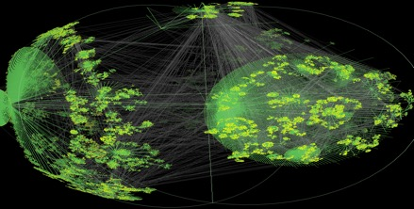
Growth of the Internet in Terms of Number of Hosts
Number of Hosts on the Internet:
Aug. 1981 213
Oct. 1984 1,024
Dec. 1987 28,174
Oct. 1990 313,000
Jan. 1993 1,313,000
Jan. 1996 9,472,000
Jan. 1999 43,218,000
Jan. 2002 147,344,723
Jan. 2005 317,646,084
Jan. 2007 433,193,199
Jan. 2010 732,740,444
Jan. 2013 963,518,598
Jan. 2016 1,048,766,623
Jan. 2017 1,062,660,523
CAIDA router
level view
http://ftp.isc.org/www/survey/reports/current/

Slide 36


Internet 3.0: Always-Connected, Virtualized Life
Office
Shopping
Education
Entertainment
Environment
=> Virtual workspace
=> Online shopping
=> Remote education
Online media/games
Internet of things

Slide 37
Internet in China
5 major networks: CHINANET, UNINET, CMNET, CERNET, CSTNET
International exit bandwidth: 8.8Tbps, 2019
4G base stations: >5.5 million (<9 million globally)
5G base stations: ~0.7 million (~70% of the world), 2020

Slide 38
Summary
Course administration
A protocol defines the format and the order of messages exchanged between two or more communicating entities, as well as the actions taken on the transmission and/or receipt of a message or other events.
The past:
facts:
The Internet started as ARPANET in late 1960s
The initial link bandwidth was 50 kbps
The number of hosts at the end of 1969 was 4
some implications of the past:
ARPANET is sponsored by ARPA →
The initial IMPs were very simple →
Many networks →
Current:
The number of hosts connected to the Internet is around 1 billions
The backbone speed of the current Internet is about 40/100 Gbps
The Internet is roughly hierarchical where ISPs interconnect at PoP and IXP
Needs to handle scale, complexity, decentralization, security
design should survive failures
keep the network simple
need a network to connect networks

Slide 39
Recap
A protocol defines the format and the order of messages exchanged between two or more communicating entities, as well as the actions taken on the transmission or receipt of a message or other events.
Key Internet milestones and their implications:
ARPANET is sponsored by ARPA →
The initial IMPs (routers) were made by a small company →
Many networks →
Commercialization →
design should survive failures
keep the network simple
internetworking: need a network to connect networks
architecture supporting decentralized, autonomous systems

Slide 40
Outline
Administrative trivia’s
A brief introduction to the Internet
past
present

Slide 41
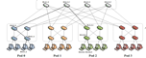
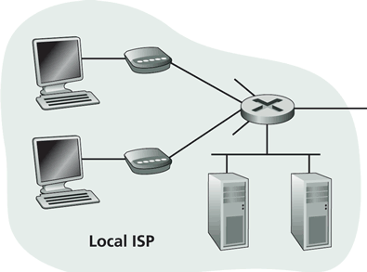
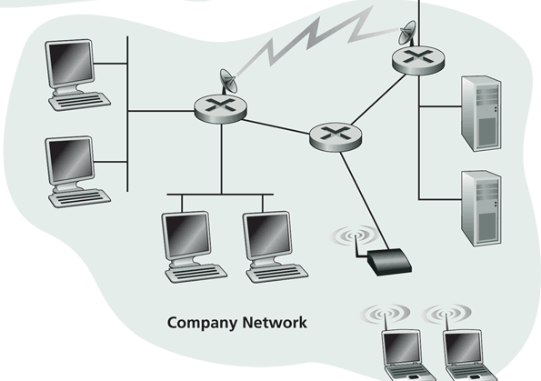
Internet Physical Infrastructure
Residential access
Cable, Fiber, DSL, Wireless
ISP
Backbone ISP
ISP
The Internet is a network of networks
Each individually administrated network is called an Autonomous System (AS)
data center
Campus access, e.g.,
Ethernet
Wireless

Slide 42
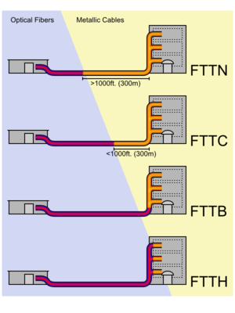
Access: Fiber to the x
http://en.wikipedia.org/wiki/Fiber_to_the_x
Notes:
the common form of gigabit Ethernet (1Gbit/s) runs over relatively economical category 5e, category 6, or augmented category 6 unshielded twisted-pair copper cabling but only to 300 ft (91 m). However, 1Gbit/s ethernet over fiber can easily reach tens of miles.

Slide 43
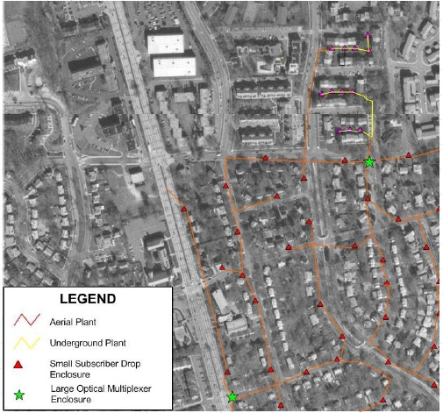
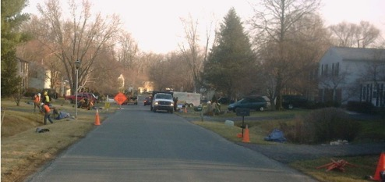
Access: Fiber to the Premises (FTTP)
Deployed by Verizon, AT&T, Google，
One of the largest comm. construction projects
Notes:
Average US:
down: 5.8 MBps
Up: 1.2 Mbps
Google fiber:
Cost: $300/customer
http://en.wikipedia.org/wiki/Fiber_to_the_x
http://www.telecompetitor.com/google-ftth-invades-texas-with-austin-the-next-stop-for-google-fiber/
http://www.youtube.com/watch?v=6uZVqPuq81c

Slide 44
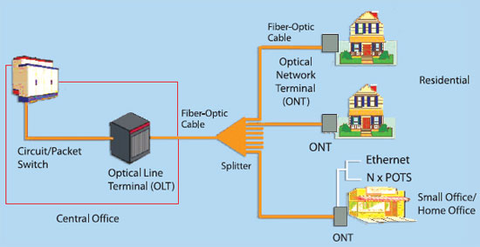
FTTP Architecture
Notes:
http://en.wikipedia.org/wiki/Fiber_to_the_x

Slide 45
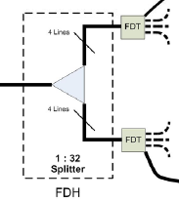
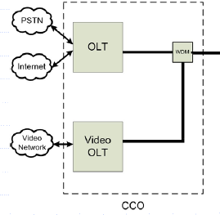
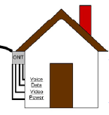
FTTP Architecture
Optical Network Terminal (ONT) box outside dwelling or business
Fiber Distribution Terminal (FDT) in poles or pedestals
Fiber Distribution Hub (FDH) at street cabinet
Optical Line Terminal (OLT) at central office

Slide 46
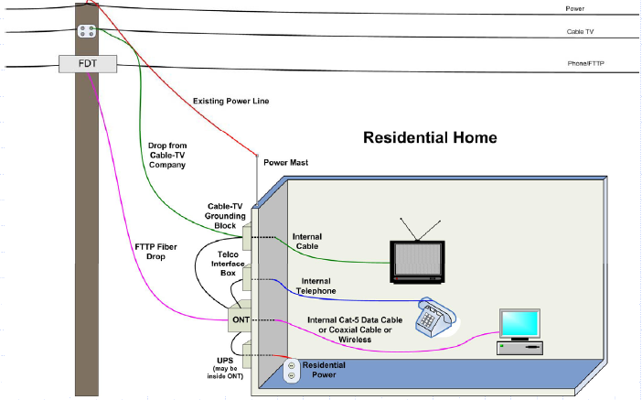
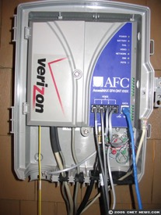
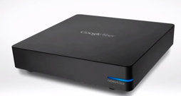
FTTP Architecture: To Home

Slide 47
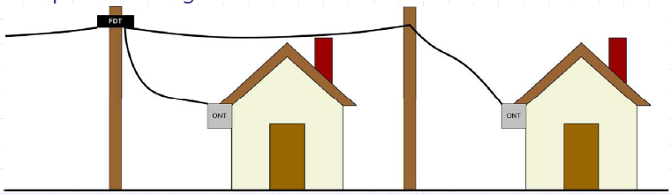
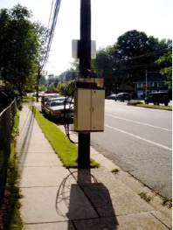
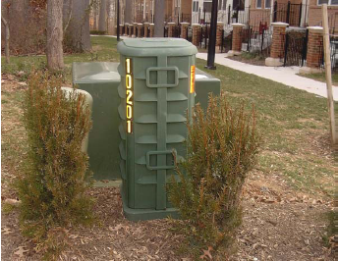
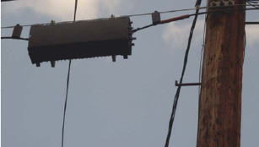
FTTP Architecture: Fiber Distribution Terminal (FDT)

Slide 48
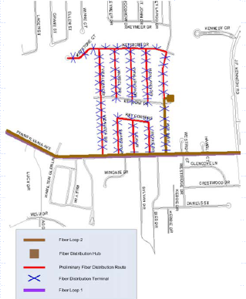
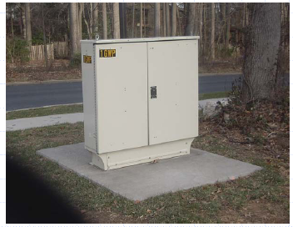
FTTP Architecture: Central to Fiber Distribution Hub (FDH)
- Backbone fiber ring on
primary arterial streets
(brown)
- Local distribution fiber
plant (red) meets backbone
at cabinet
FDH

Slide 49
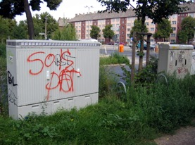
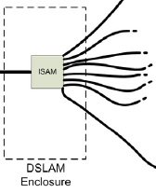
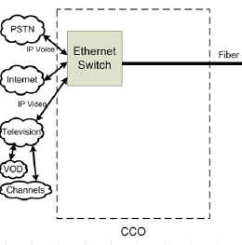
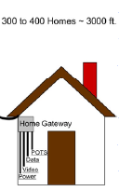
Access: DSL
Compared with FTTP, copper from cabinet (DSLAM) to home
DSLAM

Slide 50

Access: Wireless
https://x.company/loon/

Slide 51
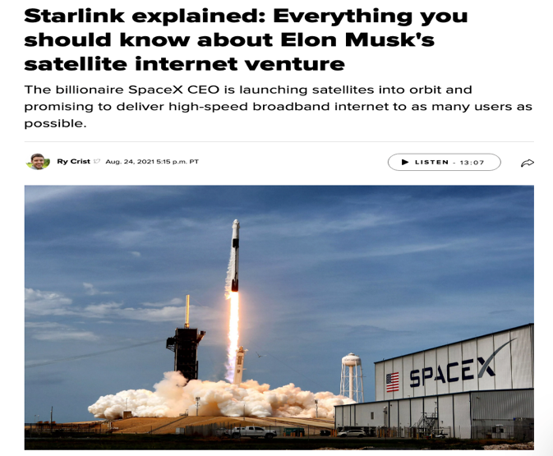
Access: Wireless
https://www.cnet.com/home/internet/starlink-satellite-internet-explained/

Slide 52

Campus Network
Internet
CE
F2
F1 (Firewall)
R1
S2
S1
LB2
LB1 (Load balancer)
IPS3
IPS2
IPS1 (Intrusion prevention)
S6
S5
S4
S3
tier-1
VLAN 200
VLAN 100
VLAN 300
VLAN 400
Logger
Tier-3
Tier-2
Tier-1

Slide 53
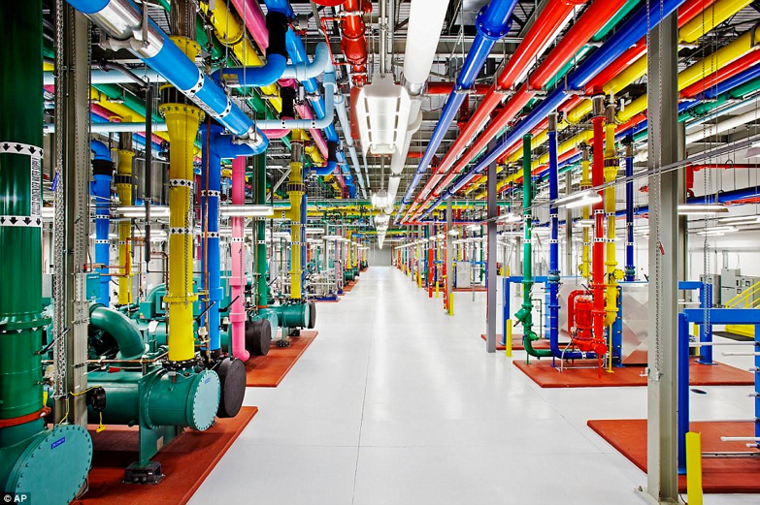
Data Center Networks
http://www.dailymail.co.uk/sciencetech/article-3369491/Google-s-plan-world-Search-engine-build-half-billion-dollar-data-center-US.html

Slide 54
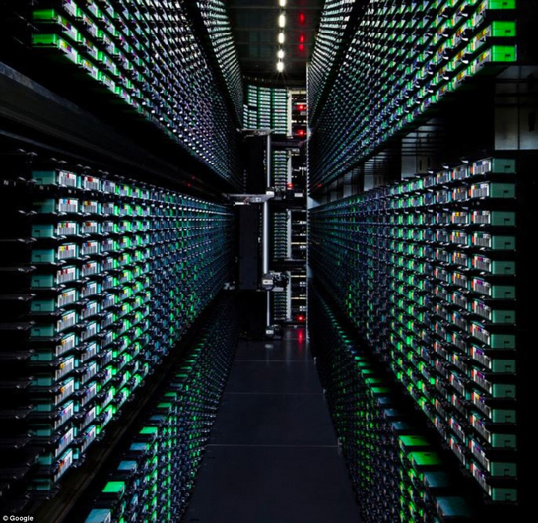
Data Center Networks
http://www.dailymail.co.uk/sciencetech/article-3369491/Google-s-plan-world-Search-engine-build-half-billion-dollar-data-center-US.html
Notes:
http://www.cse.wustl.edu/~jain/cse570-13/ftp/m_03dct.pdf

Slide 55
Foundation of Data Center Networks
1
2
n
1
2
n

Slide 56
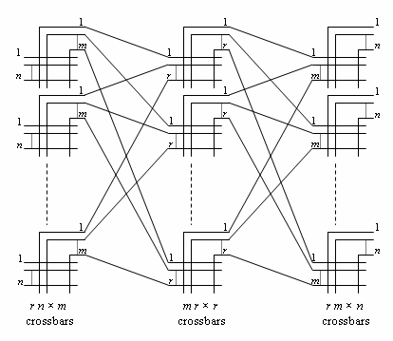
Foundation of Data Center Networks: Clos Networks
Q: How big is m so that each new call can be established w/o moving current calls?
Challenge to the class: If you can move existing calls, it is only m >= n.
https://en.wikipedia.org/wiki/Clos_network
Notes:
Strict-sense nonblocking Clos networks (m ≥ 2n−1): the original 1953 Clos result[edit]
If m ≥ 2n−1, the Clos network is strict-sense nonblocking, meaning that an unused input on an ingress switch can always be connected to an unused output on an egress switch, without having to re-arrange existing calls. This is the result which formed the basis of Clos's classic 1953 paper. Assume that there is a free terminal on the input of an ingress switch, and this has to be connected to a free terminal on a particular egress switch. In the worst case, n−1 other calls are active on the ingress switch in question, and n−1 other calls are active on the egress switch in question. Assume, also in the worst case, that each of these calls passes through a different middle-stage switch. Hence in the worst case, 2n−2 of the middle stage switches are unable to carry the new call. Therefore, to ensure strict-sense nonblocking operation, another middle stage switch is required, making a total of 2n−1.
If m ≥ n, the Clos network is rearrangeably nonblocking, meaning that an unused input on an ingress switch can always be connected to an unused output on an egress switch, but for this to take place, existing calls may have to be rearranged by assigning them to different centre stage switches in the Clos network.^{[3]} To prove this, it is sufficient to consider m = n, with the Clos network fully utilised; that is, r×n calls in progress. The proof shows how any permutation of these r×n input terminals onto r×n output terminals may be broken down into smaller permutations which may each be implemented by the individual crossbar switches in a Clos network with m = n.
The proof uses Hall's marriage theorem^{[4]} which is given this name because it is often explained as follows. Suppose there are r boys and r girls. The theorem states that if every subset of k boys (for each k such that 0 ≤ k ≤ r) between them know k or more girls, then each boy can be paired off with a girl that he knows. It is obvious that this is a necessary condition for pairing to take place; what is surprising is that it is sufficient.
In the context of a Clos network, each boy represents an ingress switch, and each girl represents an egress switch. A boy is said to know a girl if the corresponding ingress and egress switches carry the same call. Each set of k boys must know at least k girls because k ingress switches are carrying k×n calls and these cannot be carried by less than k egress switches. Hence each ingress switch can be paired off with an egress switch that carries the same call, via a one-to-one mapping. These r calls can be carried by one middle-stage switch. If this middle-stage switch is now removed from the Clos network, m is reduced by 1, and we are left with a smaller Clos network. The process then repeats itself until m = 1, and every call is assigned to a middle-stage switch.

Slide 57
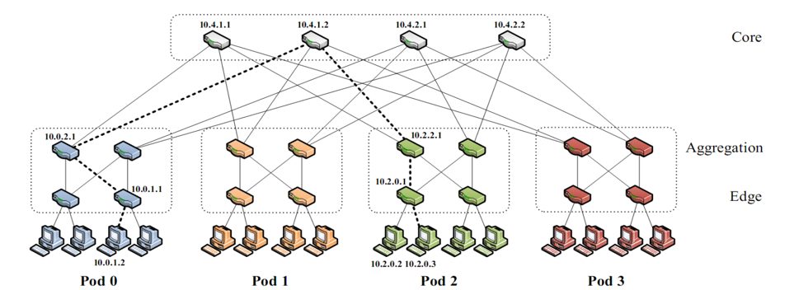
Data Center Networks: Fat-tree Networks
K-ary fat tree: three-layer topology (edge, aggregation and core)
k pods w/ each pod consists of (k/2)² servers & 2 layers of k/2 k-port switches
each edge switch connects to k/2 servers & k/2 aggr. switches
each aggr. switch connects to k/2 edge & k/2 core switches
(k/2)² core switches: each connects to k pods
Q: How large a network can k-ary support using k-port switches?
http://www.cs.cornell.edu/courses/cs5413/2014fa/lectures/08-fattree.pdf
Notes:
K^3/4
http://www.fiber-optic-tutorial.com/100g-switch-price-and-configuration.html
http://web.stanford.edu/class/ee384y/Handouts/clos_networks.pdf
https://en.wikipedia.org/wiki/Clos_network

Slide 58
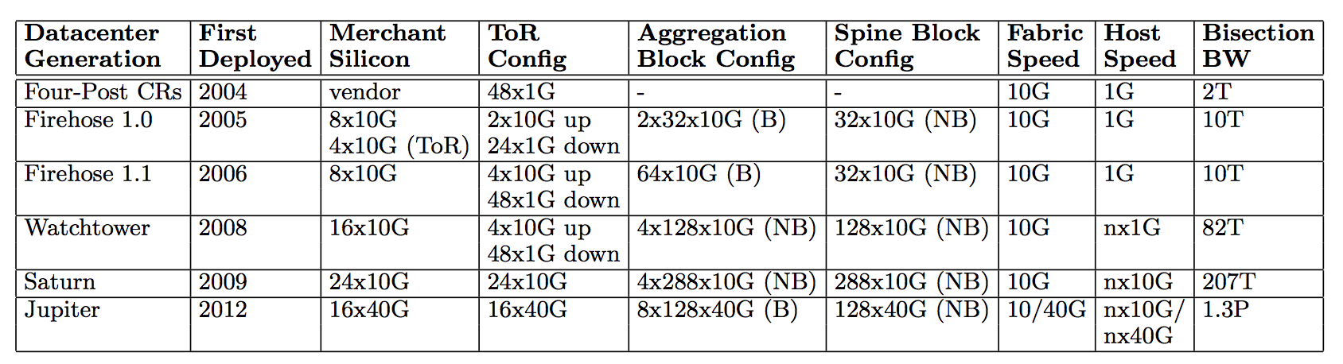
Data Center Networks
For example, Google Jupiter at 1 Pbits/sec bisection bw: 100,000 servers at 10G each
http://googlecloudplatform.blogspot.com/2015/06/A-Look-Inside-Googles-Data-Center-Networks.html
http://conferences.sigcomm.org/sigcomm/2015/pdf/papers/p183.pdf
Notes:
http://web.stanford.edu/class/ee384y/Handouts/clos_networks.pdf
https://en.wikipedia.org/wiki/Clos_network

Slide 59
Recall: Internet Physical Infrastructure
Residential access, e.g.,
Cable, Fiber, DSL, Wireless
ISP
Backbone ISP
ISP
The Internet is a network of networks
Each individually administrated network is called an Autonomous System (AS)
data center
Campus access, e.g.,
Ethernet, Wireless

Slide 60
Yale Internet Connection
traceroute www.tsinghua.edu.cn
1 college.net.yale.internal (172.28.201.65) 1.440 ms 1.227 ms 1.453 ms
2 10.1.1.13 (10.1.1.13) 1.359 ms 1.153 ms 1.173 ms 3 level3-10g-asr.net.yale.internal (10.1.4.40) 2.786 ms 6.110 ms 2.547 ms 4 cen-10g-yale.net.yale.internal (10.1.3.102) 2.646 ms 3.242 ms 2.576 ms 5 * * * 6 enrt064hhh-9k-te0-3-0-5.net.cen.ct.gov (67.218.83.254) 5.169 ms 3.797 ms 6.891 ms 7 198.71.46.215 (198.71.46.215) 3.615 ms 3.742 ms 3.931 ms 8 et-10-0-0.1180.rtsw.newy32aoa.net.internet2.edu (198.71.46.214) 6.661 ms 6.532 ms 6.310 ms 9 et-4-0-0.4079.sdn-sw.phil.net.internet2.edu (162.252.70.103) 8.658 ms 8.714 ms 8.666 ms 10 et-1-1-0.4079.rtsw.wash.net.internet2.edu (162.252.70.119) 11.787 ms 30.111 ms 11.900 ms 11 et-8-1-0.4079.sdn-sw.ashb.net.internet2.edu (162.252.70.62) 12.428 ms 16.654 ms 15.862 ms 12 et-7-1-0.4079.rtsw.chic.net.internet2.edu (162.252.70.61) 28.898 ms 28.999 ms 28.908 ms 13 et-3-1-0.4070.rtsw.kans.net.internet2.edu (198.71.47.207) 40.084 ms 39.958 ms 39.695 ms 14 et-8-0-0.4079.sdn-sw.denv.net.internet2.edu (162.252.70.10) 50.195 ms 50.562 ms 50.258 ms 15 et-4-1-0.4079.rtsw.salt.net.internet2.edu (162.252.70.9) 59.707 ms 60.261 ms 59.762 ms 16 et-7-0-0.4079.sdn-sw.lasv.net.internet2.edu (162.252.70.30) 67.555 ms 67.539 ms 67.312 ms 17 et-4-1-0.4079.rtsw.losa.net.internet2.edu (162.252.70.29) 72.419 ms 72.428 ms 72.376 ms ...

Slide 61
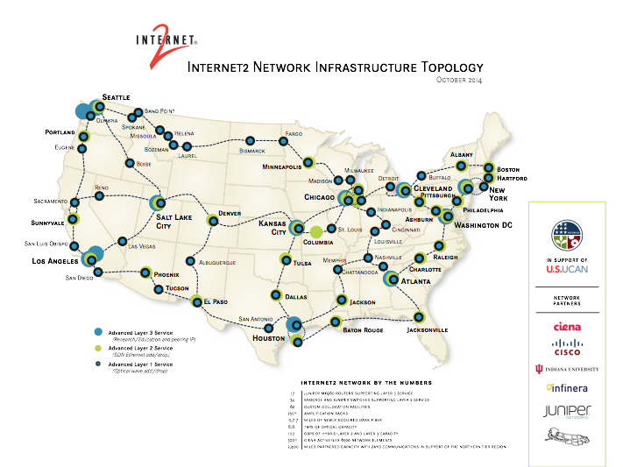
Internet2
\
http://noc.net.internet2.edu/i2network/maps-documentation/maps.html#Internet2 Combined Infrastructure Network Map

Slide 62
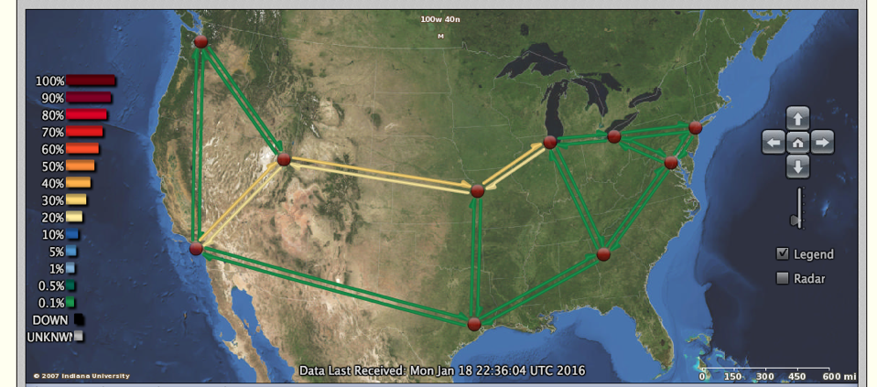
Internet2
http://atlas.grnoc.iu.edu/atlas.cgi?map_name=Internet2%20IP%20Layer

Slide 63
XMU Internet Connection
Try traceroute from XMU to
www.microsoft.com
www.baidu.com
www.sina.com.cn
www.taobao.com

Slide 64
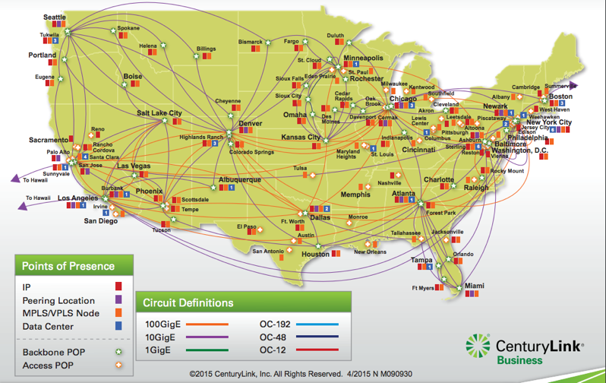
Qwest Backbone Map
Qwest (CentryLink) Network Maps
http://www.centurylink.com/business/asset/network-map/ip-mpls-network-nm090930.pdf
http://www.centurylink.com/business/resource-center/network-maps/

Slide 65
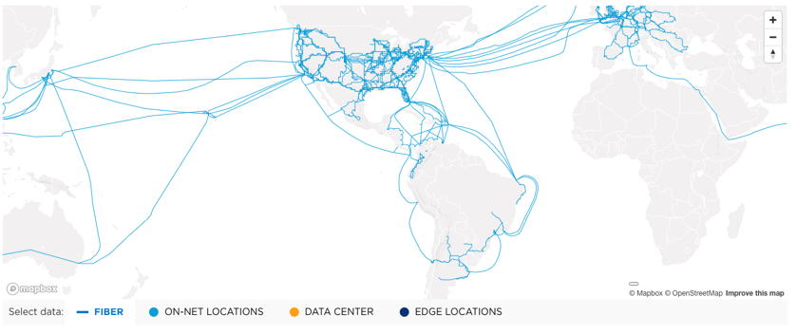
Level3 (now part of LUMEN) Network Map
https://www.lumen.com/en-us/resources/network-maps.html

Slide 66
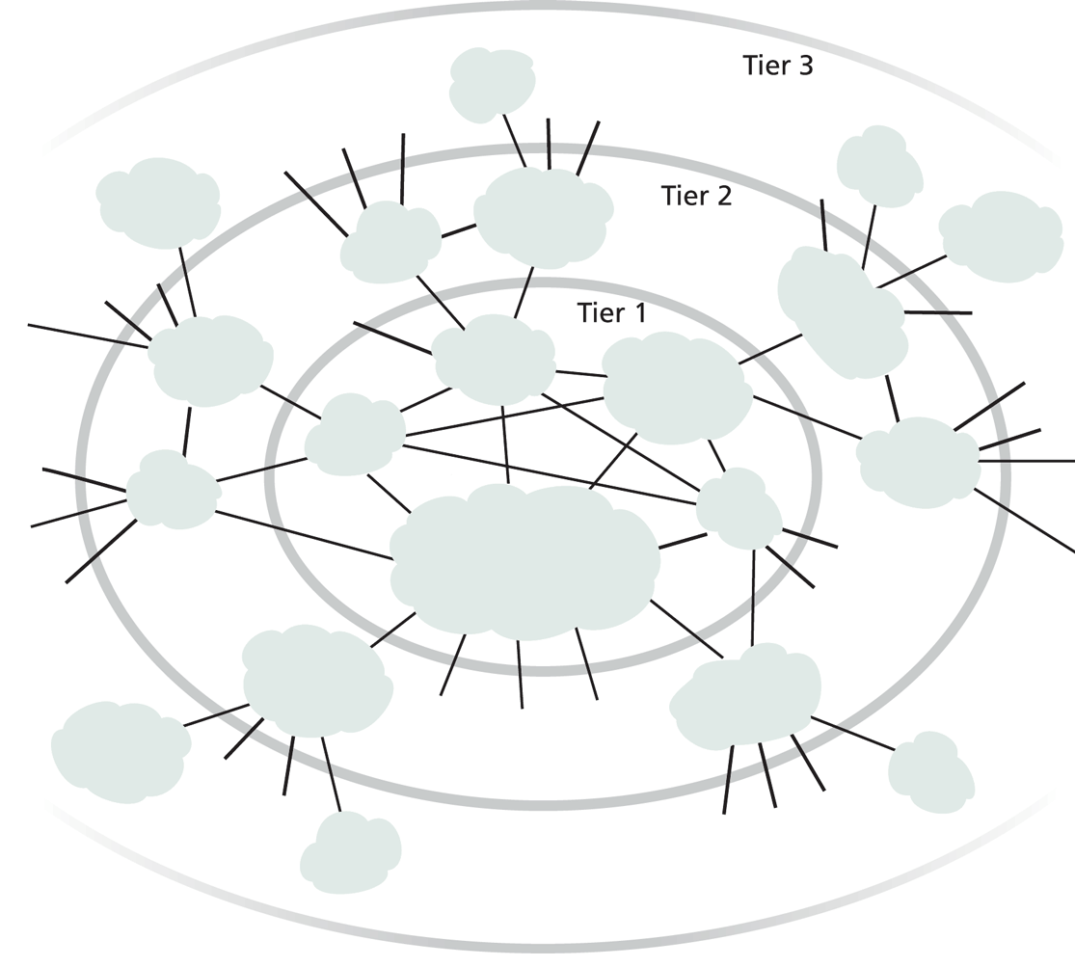
Internet ISP Connectivity
Roughly hierarchical
Divided into tiers
Tier-1 ISPs are also called backbone providers, e.g., AT&T, Verizon, Sprint, Level 3, Qwest
An ISP runs (private) Points of Presence (PoP) where its customers and other ISPs connect to it
ISPs also connect at (public) Internet Exchange Point (IXP)
public peering
http://en.wikipedia.org/wiki/List_of_Internet_exchange_points_by_size

Slide 67
Outline
Administrative trivia’s
A brief introduction to the Internet
past
present
topology
traffic

Slide 68
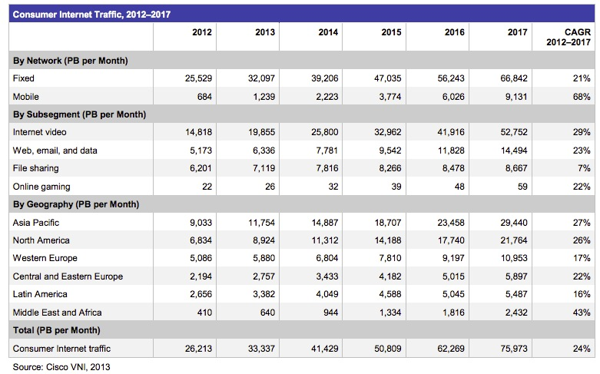
Internet (Consumer) Traffic
Notes:
http://www.cisco.com/en/US/solutions/collateral/ns341/ns525/ns537/ns705/ns827/white_paper_c11-481360.pdf

Slide 69
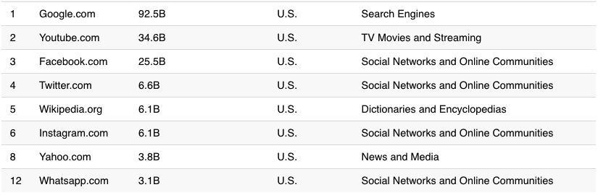
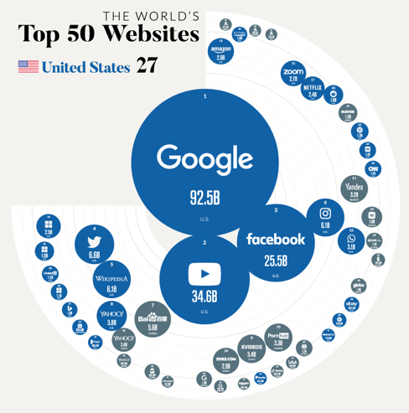
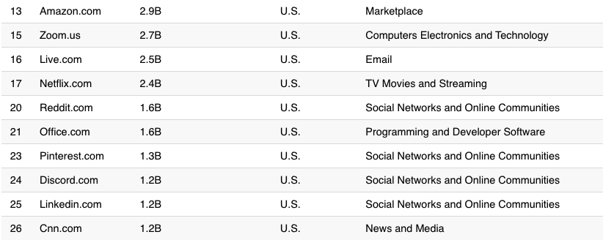
Largest Internet Sites in the World
https://www.visualcapitalist.com/wp-content/uploads/2021/01/Country-With-the-Most-Websites.html
Notes:
http://www.comscore.com/Insights/Press_Releases/2013/8/comScore_Media_Metrix_Ranks_Top_50_U.S._Web_Properties_for_July_2013

Slide 70
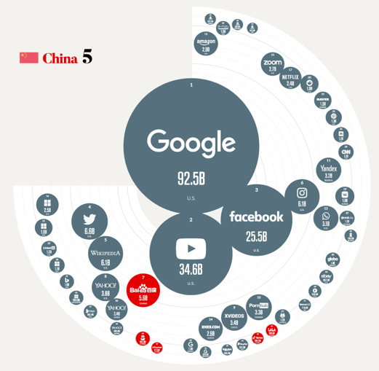
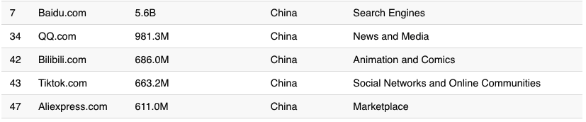
Largest Internet Sites in the World
https://www.visualcapitalist.com/the-50-most-visited-websites-in-the-world/

Slide 71


Internet Traffic in Perspective
640K ought to be enough for anybody.

Slide 72
Outline
Administrative trivia’s
A brief introduction to the Internet: past and present
Challenges of Internet networks and apps

Slide 73

Scale
“Developers who have worked at the small scale might be asking themselves why we need to bother when we could just use some kind of out-of the-box solution. For small-scale applications, this can be a great idea. We save time and money up front and get a working and serviceable application. The problem comes at larger scales—there are no off-the-shelf kits that will allow you to build something like Amazon... There’s a good reason why the largest applications on the Internet are all bespoke creations: no other approach can create massively scalable applications within a reasonable budget.”
http://www.evontech.com/symbian/55.html

Slide 74
General Complexity
Complexity in highly organized systems arises primarily from design strategies intended to create robustness to uncertainty in their environments and component parts.
Scalability is robustness to changes to the size and complexity of a system as a whole.
Evolvability is robustness of lineages to large changes on various (usually long) time scales.
Reliability is robustness to component failures.
Efficiency is robustness to resource scarcity.
Modularity is robustness to component rearrangements.
David Meyer

Slide 75

Core: Simple Forwarding to Network Functions
Modern networks contain diverse types of equipment beyond simple routing/forwarding
Enterprise networks
Small: <=1k hosts; Medium: 1k-10k; Large: 10k-100k; Very Large: >= 100k
Source: [Sherry, et. al SIGCOMM’12]

Slide 76

Centralized vs Decentralized (Price of Anarchy)
Autonomous (“Selfish”) App: Assume each link has a latency function l_{e}(x): latency of link e when x amount of traffic goes through e:
l(x) = x
total traffic
s
t
l(x) = 1

Slide 77



Autonomous (“Selfish”) App
Braess’s paradox
Notes:
Every increase of 20 ms in latency leads to 1% drop in click-through rate
E-commerce abandonment zone:
33% users will abandon a site takes longer than 4 sec [Jupiter]

Slide 78
Decentralized (“Selfish”) Users
preferred
2 0
2 3 0
2
4
less
preferred
0
3 1 0
3 0
1 2 0
1 0
1
3
3

Slide 79
Decentralized (“Selfish”) Users
preferred
2 3 0
2 0
2
4
less
preferred
0
3 1 0
3 0
1 2 0
1 0
1
3
3

Slide 80

Distributed vs Centralized
Distributed computing is hard, e.g.,
FLP Impossibility Theorem
Arrow’s Impossibility Theorem
Achieved good design for only few specific tasks (e.g., state distribution, leader election). Hence, a trend in networking is Software Defined Networking, which is a way of moving away from generic distributed computing, by focusing on utilizing the few well-understood primitives, in particular logically centralized state.

Slide 81
What Will We Cover?
Network architecture and design principles
Layered network arch; e2e principle
Application architecture and design principles
application paradigms; high performance network app.
HTTP/Web, Email, DNS, P2P, Blockchain, Content distribution
Transport
transport services
reliability; distributed resource allocation; primal-dual
transport protocols: TCP/UDP

Slide 82
What Will We Cover?
Network and link layers
distributed, asynchronous, autonomous routing algorithms; scalable router design; IP/IPv6; mobile IP; cellular networks
multiple access; queueing analysis; capacity analysis
Next-generation network:
Cloud and data center design, programmable networks, RDMA
Physical layer
Wireless Networks
Network security
security primitives; BAN logic, SSL

Slide 83
Guest Lectures (Tentative Topics)
Managing Alibaba's global network:
Ennan Zhai: Senior Researcher@Alibaba
High-Performance Azure Data Center:
Wei Bai: Senior Researcher@Microsoft
In-Network Computing via Programmable Networks:
Alan Liu: Assistant Professor@Boston University
Large-Scale 5G Measurement Studies in China:
Zhenhua Li: Associate Professor@Tsinghua University

Slide 84
Recall: Internet Physical Infrastructure
Residential access, e.g.,
Cable, Fiber, DSL, Wireless
ISP
Backbone ISP
ISP
The Internet is a network of networks
Each individually administrated network is called an Autonomous System (AS)
~ 58000 ASes; Avg 5.7 hops; (http://bgp.potaroo.net/as2.0/bgp-active.html)
data center
Campus access, e.g.,
Ethernet, Wireless

Slide 85
Roadmap
So far we have looked at only the topology and physical connectivity of the Internet: a mesh of computers interconnected via various physical media
A basic question: how are data (the bits) transferred through communication networks?

Slide 86
Outline
Administrative trivia’s
A brief introduction to the Internet: past and present
Challenges of Internet networks and apps
A taxonomy of communication networks

Slide 87
Taxonomy of Communication Networks
communication networks
switched networks
broadcast networks
Broadcast networks
nodes share a common channel; information transmitted by a node is received by all other nodes in the network
examples: TV, radio
Switched networks
information is transmitted to a small sub-set (usually only one) of the nodes

Slide 88
A Taxonomy of Switched Networks
communication networks
switched networks
broadcast networks
circuit-switched networks (e.g., telephone)
packet-switched networks (e.g., Internet)
Circuit switching: dedicated circuit per call/session:
e.g., telephone, cellular voice
Packet switching: data sent thru network in discrete “chunks”
e.g., Internet, cellular data

Slide 89
Outline
Admin. and recaps
A brief introduction to the Internet: past and present
Challenges of Internet networks and apps
A taxonomy of communication networks
circuit switched networks

Slide 90


Circuit Switching
Each link has a number of “circuits”
sometime we refer to a “circuit” as a channel or a line
An end-to-end connection reserves one “circuit” at each link
First commercial telephone switchboard was opened in 1878 to serve the 21 telephone customers in New Haven
Notes:
http://www.classicrotaryphones.com/new-england-operators2_big.jpg

Slide 91

Circuit Switching: Resources/Circuits (Frequency, Time and others)
Divide link resource into “circuits”
frequency division multiplexing (FDM)
time division multiplexing (TDM)
others such as code division multiplexing (CDM), color/lambda division

Slide 92
Circuit Switching: The Process
Three phases
circuit establishment
data transfer
circuit termination

Slide 93
Timing Diagram of Circuit Switching
Host A
Host B
Node 1
Node 2
processing delay at Node 1
DATA
propagation delay
from A to Node 1
circuit establishment
propagation delay
from B To A
data transmission
circuit termination

